Slide 1
WELCOME

Slide 2
TEAM MEMBERS
Member 1: Gowtham.G ,
Member 2: Dhayanethi.V,
Member 3: Gunanithi.R,
Member 4: Ragunath.K,
Guide
Mr.K.Sivanantham,
ECE Department .

Slide 3
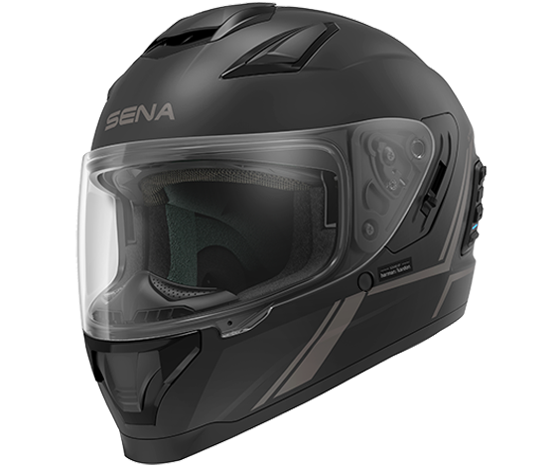
Smart Helmat

Slide 4
Introduction
The main objective of this system is to design a helmet that provides safety to bike riders.
We are developing a smart helmet using the internet of things (IoT) technology
The system detects whether the rider is wearing a helmet or not if he wears then only the vehicle will start.

Slide 5
Components using
Co2 Gas sensor
Transmitter
Receiver
Servo motor
Nodemcu [ESP8266]

Slide 6

Co2 Gas sensor

Slide 7
Co2 Gas sensor
To detect co2 level
Inhale 0.03%
Exhale 4%
Detect co2 level inside Helmet

Slide 8
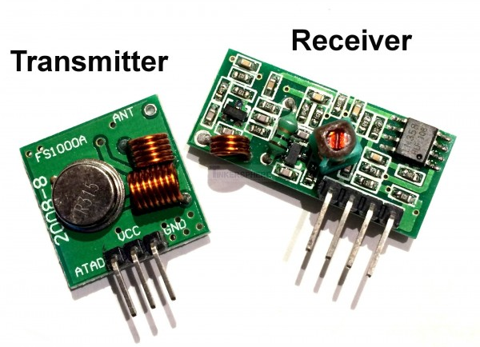
Transmitter and Receiver

Slide 9
Transmitter and Receiver
Electricity flowing into Transister
Produce and transmit wave form
Wave form Received by Receiver

Slide 10
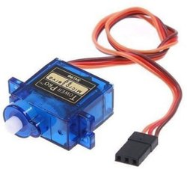
Servo motor
Allows for precise control of angular position
Controlled by arduino
Used in key latch

Slide 11
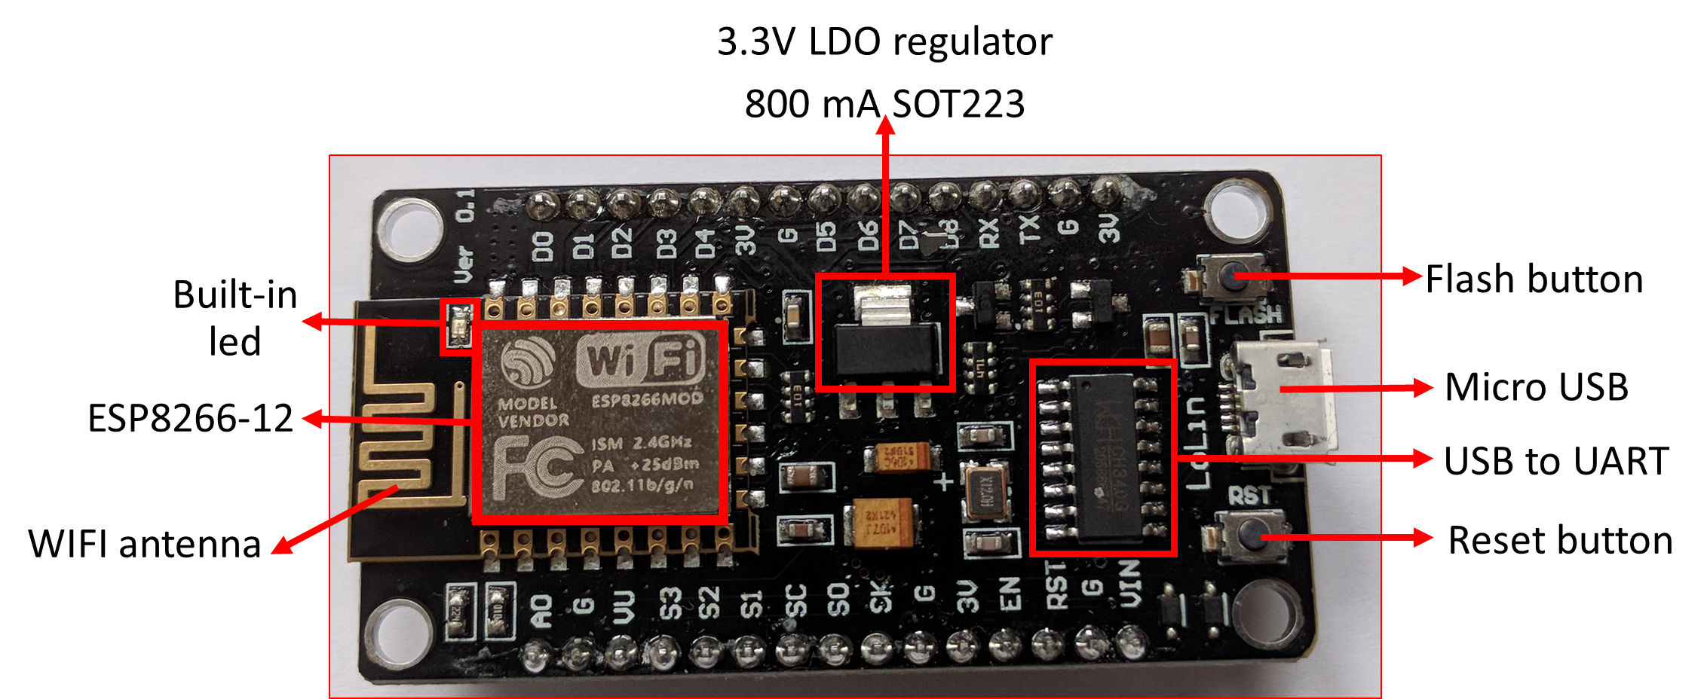
NodeMCU [ESP8266]
Wifi module
Used for program output

Slide 12
Motivation
Compulsory helmet
Avoid accident
Develop the technology

Slide 13
flowchart
Wear helmet
Co2 sensor detect co2 level
Ride will start
Transmitter generate wave form
Receiver received the wave form
Keylatch will open

Slide 14
Future scope
In future we are going to fix face detection sensor
In that helmet, detect the face and start ignition for engine and also develop the danger alram and security alert……….
Its is very usefull to our life while driving
Our main motive is to all should wear helmet

Slide 15
Conclution
The designed Smart helmet ensures the safety of the rider by making it necessary to wear helmet
The system also helps in efficient handling of the aftermath of accidents
WEAR HELMET * * *

